Slide 1
Designing Effective Input
12
Systems Analysis and Design, 8e
Kendall & Kendall

Slide 2
Learning Objectives
Design input forms for users of business systems.
Design engaging input displays for users of information systems.
Design useful input forms for people interacting on the Web.
Design useful input pages for users of intranets and the Internet.

Slide 3
Input Design Objectives
The quality of system input determines the quality of system output.
Input design objectives:
Effectiveness – specific purpose
Accuracy – design for proper completion
Ease of use – forms & displays are straightforward
Consistency – grouping data similarly
Simplicity – keeping deigns uncluttered
Attractiveness – users will enjoy using forms
Notes:
Effectiveness – all serve specific purposes for users of the information system.
Accuracy – design that ensures proper completion.
Ease of use – straight forward and require no extra time to decipher.
Consistency – group data similarly from one application to the next.
Simplicity – keeping designs uncluttered in a manner that focuses the user’s attention.
Attractiveness – appealing design.

Slide 4
Good Form Design
Make forms easy to fill in.
Ensure that forms meet the purpose for which they are designed.
Design forms to assure accurate completion.
Keep forms attractive.
Notes:
Forms often serve as source documents for users or for input to ecommerce applications that humans must enter.

Slide 5
Make Forms Easy to Fill in
Form flow
Seven sections of a form
Captioning
Notes:
First, design forms with proper flow, from left to right and top to bottom.
Second, group information logically using the seven sections of a form.
Third, provide people with clear captions.

Slide 6
Form Flow
Can minimize the time and effort expended in form completion
Should flow from left to right and top to bottom ☺☺
Notes:
Illogical flow takes extra time and is frustrating.

Slide 7
Seven Sections of a Form
Heading
Identification and access
Instructions
Body
Signature and verification
Totals
Comments

Slide 8
Caption Types
Line caption
Putting the caption on the same line or below the line
Boxed caption
Providing a box for data instead of a line
Check off caption
Lining up choices or alternatives vertically
Horizontal check off caption
Lining up choices or alternatives horizontally
Table caption
Work well in the body of a form
Combination
Notes:
Captions tell the person filling out the form what to put in a blank line, space, or box.

Slide 9
Major Captioning Alternatives (Figure 12.2)

Slide 10
Meeting the Intended Purpose
Systems analysts may use different types of specialty forms for different purposes.
Specialty forms
Multiple-part
Continuous-feed
Perforated
Notes:
Sometimes it is desirable to provide different information to different departments or users but still share some basic information.

Slide 11
Ensuring Accurate Completion
To reduce error rates associated with data collection, forms should be designed to assure accurate completion.
Design forms to make people do the right thing with the form.

Slide 12
Keeping Forms Attractive
Artistic forms draw people into them and encourage completion.
Forms should look uncluttered, and elicit information in the expected order.
Using different fonts and line weights within the same form can help make it more attractive for users.
Notes:
Proper layout and flow contribute to a form’s attractiveness.
Type fonts and line weights are useful design elements for capturing attention and making people feel secure that they are filling in the form correctly.

Slide 13
Computer-Assisted Form Design
Numerous form design packages are available for PCs.
There are tools to set up:
Fields
Check boxes
Lines
Boxes
Notes:
Omniform by ScanSoft is an example of a design package.

Slide 14
Omniform from ScanSoft Allows the User to Take an Existing Form, Scan it into the Computer, and Define Fields so the Form Can Be Easily Filled out on a PC

Slide 15
Controlling Business Forms
Make sure that each form in use fulfills its specific purpose.
Make sure that the specified purpose is integral to organizational functioning.
Prevent duplication of information collected and of the forms that collect it.
Decide on how to reproduce forms in the most economical way.
Establish procedures that make forms available, at the lowest possible cost.

Slide 16
Good Display and Web Forms Design
Keep the display simple.
Keep the display presentation consistent.
Facilitate user movement among display screens and pages.
Create an attractive and pleasing display.
Notes:
Differences for displays:
presence of cursor
can include context-sensitive help
hyperlinks

Slide 17
Keeping the Display Simple
Heading
Body
Comments and instructions
Notes:
The display should show only that which is necessary for the particular action being undertaken.
Heading – contains titles of software and open files, pull-down menus, and icons that do certain tasks.
Body – used for data entry and is organized from left to right and top to bottom.
Comments and instructions – displays a short menu of commands that remind the user of basics

Slide 18
Keeping the Display Consistent
Locate information in the same area each time a new display is accessed.
Information that logically belongs together should be consistently grouped together.
Information should not overlap from one group to another.

Slide 19
Facilitating Movement
The three-clicks rule says that users should be able to get to the screens they need within three mouse or keyboard clicks.
Movement among screens:
Scrolling by using arrows or PgDn keys
Context-sensitive pop-up windows
Onscreen dialogue

Slide 20
Designing an Attractive and Pleasing Display
Should draw users into them and hold their attention
Use logical flows in the plan to your display pages
Color or shaded boxes and creating three-dimensional boxes and arrows
Notes:
If users find displays appealing they are likely to be more productive, need less supervision, and make fewer errors.

Slide 21
Using Icons in Screen Design
Icons are pictorial, onscreen representations symbolizing computer actions that users may select using a mouse, keyboard, lightpen, touch screen, or joystick.
Shapes should be readily recognizable.
Icons for a particular application should be limited to 20 recognizable shapes.
Use icons consistently throughout.
Notes:
Icons are pictorial, onscreen representation symbolizing computer actions that users may select using a mouse, keyboard, lightpen, touch screen or joystick – serve function similar to words.
Shapes should be readily recognizable – so the user is not required to master a new vocabulary.
Icons for a particular application should be limited to 20 recognizable shapes – so that icon vocabulary is not overwhelming and a coding scheme can still be realized.
Use icons consistently throughout – this ensures continuity and understanding.

Slide 22
Graphical User Interface (GUI) Controls
Text boxes
Check boxes
Option or radio buttons
List and drop-down list boxes
Sliders and spin buttons
Image maps
Text area
Message boxes
Notes:
GUI is sometimes referred to as point-and-click.

Slide 23
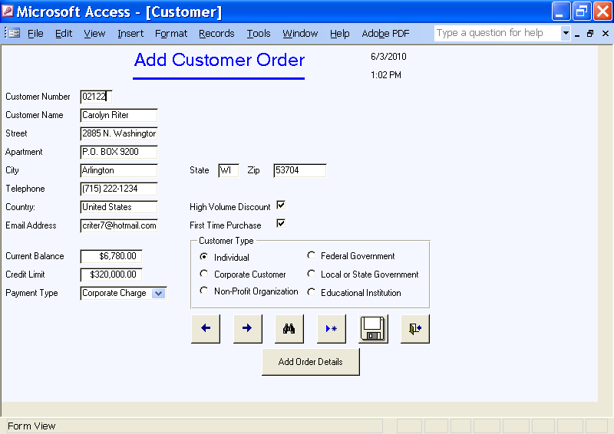
The Designer Has Many GUI Components that Allow Flexibility in Designing Input Screens for the Web or Other Software Packages: This Example Is from Microsoft Access

Slide 24
Text Boxes
Text boxes should be large enough to accommodate all the characters.
Captions should be to the left of the text box.
Character data is left-aligned within the box.
Numeric data is right-aligned.
Notes:
A rectangle represents a text box and is used to outline data entry and display fields.

Slide 25
Check Boxes
Check boxes are used for nonexclusive choices(not restricted)
Check box text or label is placed to the right of the check box.
If there are more than ten check boxes, group together in a bordered box.
Notes:
Check boxes contain an X or are empty, corresponding to whether or not the user selected the option.

Slide 26
Option Buttons
Option or radio buttons are used for exclusive choices.
Choices are listed to the right of the button, in some sequence.
Often they are placed in a rectangle called an option group.
Note: If more than six option buttons are used, a list box or drop-down list box should be implemented.
Notes:
A circle called an option button or a radio button, is used to select exclusive choices.

Slide 27
List and Drop-Down List Boxes
Used when there is little room available on the page
If there is a commonly selected choice, it is usually displayed in the drop-down list by default.
Notes:
A list box displays several options that may be selected with the mouse.

Slide 28
Tab Control Dialogue Boxes
Create a separate tab for each unique feature.
Place the most commonly used tabs in front and display them first.
Consider including three basic buttons in your design:
OK
Cancel
Help

Slide 29
Sliders, Spin Buttons, and Image Maps
Sliders and spin buttons are used to change data that have a continuous range of values.
Image map fields are used to select values within an image.
Notes:
Sliders and spin buttons give users more control when choosing values.
Image maps are used when creating Web pages containing maps with instructions to click in a certain area in order to view a detailed map of the region.

Slide 30
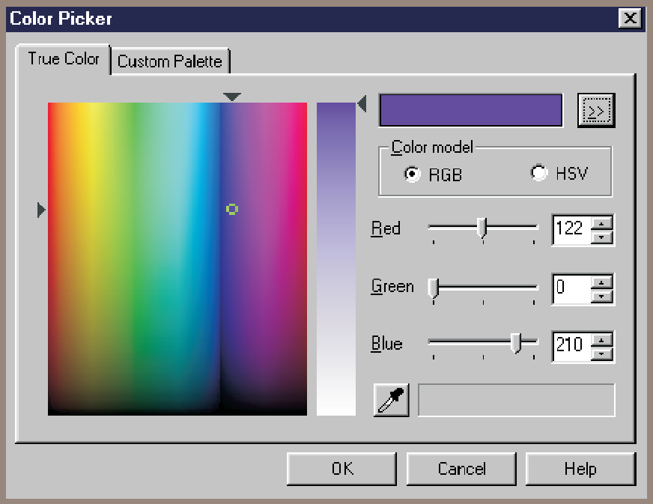
Sliders and Spin Buttons Are Two Additional GUI Components the Analyst Can Use to Design Input Screens

Slide 31
Text Area
A text area is used for entering a larger amount of text.
Can view data larger then the box area
Handling text:
Hard return is used to force new lines.
Use word wrap within the text area.
Notes:
Text areas can include a number of rows, columns, and scroll bars that allow the user to enter and view text greater than the size of the box area.

Slide 32
Message Boxes and Command Buttons
Message boxes are used to warn users and provide feedback messages in a dialog box.
Command buttons perform an action when the user selects it.
Notes:
Each message box should appear in a rectangular window and should spell out the message so the user knows precisely what is happening and what actions are possible.
Calculate Total, Add Order, OK, are examples of command buttons.

Slide 33
Form Controls and Values
Each control in a GUI interface stores data associated with the control.

Slide 34
Hidden Fields
Not visible to the viewer
Do not take up any space on the Web page
Can only contain a name and value
Used to store values sent from one Web form to the server
Notes:
Used to retain information about the type of browser being used; the viewer’s operating system, and so on. Sometimes a hidden field will contain a key field used to locate a record for the customer or the browsing session.

Slide 35
Event-Response Charts
Used to:
List the variety of events that can occur.
Show what should happen.
Build a Web form that requires minimal action from the user.
Explore improvements to the Web page.
Events may be used to:
Control navigation between Web pages.
Change the contents of drop-down lists.
Notes:
Events may be clicking a button, changing a value, the field receives focus, blurring a field, loading the Web page, detecting keystrokes and so on.

Slide 36
Dynamic Web Pages
Web pages that change themselves as the result of some user action
Advantage
Modify themselves quickly
Disadvantage
Will not work if JavaScript is turned off
Notes:
Dynamic Web pages use JavaScript to modify some part of the Web page, or a style.
Modify themselves quickly – since they have fewer interruptions to send and receive data from the server.

Slide 37
Color
The five most readable foreground/background color combinations:
Black on yellow
Yellow on black
Green on white
Blue on white
White on blue
Notes:
Color is an appealing and proven way to facilitate users with tasks requiring computer input.
Color allows you to:
contrast foreground and background
highlight important fields
feature errors
highlight special code input
call attention to other special attributes

Slide 38
Intranet and Internet Page Design
Provide clear instructions.
Demonstrate a logical entry sequence for fill-in forms.
Use a variety of text boxes, push buttons, radio buttons, drop-down lists, and other GUI features.
Provide a scrolling text box if you are uncertain how much text will be entered.

Slide 39
Intranet and Internet Page Design (Continued)
Include two basic buttons: Submit and Clear.
If the form is lengthy, divide it into several simpler forms on separate pages.
Create a feedback screen that lists error messages if a form has not correctly been filled out.

Slide 40
Ecommerce Applications
Ecommerce applications involve more than just good designs of Web sites.
Customers need to feel confident in the site
Shopping cart
Notes:
Customers need to feel confident they are buying the correct quantity, that they are getting the right price, and that the total cost of an Internet purchase, including shipping charges, is what they expect.
The most common way to show establish confidence is to use the metaphor of a shopping cart or shopping bag. An important feature of the shopping cart is that the user can edit the quantity of the item ordered or can remove the item entirely.

Slide 41
Summary
Guidelines for well-designed input forms:
Forms must be easy to fill out.
Forms must meet the purpose for which they are designed.
Forms must be designed to ensure accurate completion.
Forms must be pleasing and attractive.

Slide 42
Summary (Continued)
Guidelines for well-designed displays:
Displays must be kept simple.
Displays must be consistent in presentation.
Design must facilitate movement between pages.
Displays must be attractive.

Slide 43
Summary (Continued)
Guidelines for Web fill-in forms:
Provide clear instructions.
Demonstrate a logical entry sequence for fill-in forms.
Use a variety of text boxes, push buttons, drop-down menus, check boxes, and radio buttons.
Provide a scrolling text box if you are uncertain about how much space users will need to respond to a question.

Slide 44
Summary (Continued)
Guidelines for Web fill-in forms (continued):
Prepare two basic buttons on every Web fill-in form: Submit and Clear Form.
If the form is lengthy and the users must scroll extensively, divide the form into several simpler forms on separate pages.
Create a feedback screen that highlights errors in an appropriate color and refuses submission of the form until mandatory fields are correctly filled in.

